Slide 1
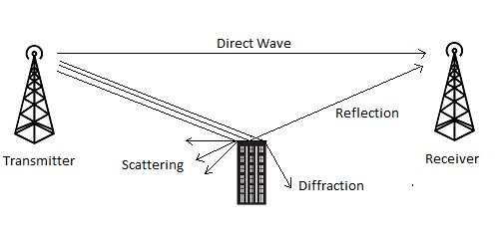
TECHNICAL CHALLENGES INVOLVED
Unit 1 Chapter 2 and 3 : WIRELESS
COMMUNICATIONS
Andreas F. Molisch
2.1,2.2,2.3 and 2.4 && 3.2
For more details on Fading refer 5.9 of Upena Dalal

Slide 2
Challenges includes:
multipath propagation
spectrum limitations
energy limitations
user mobility.

Slide 3
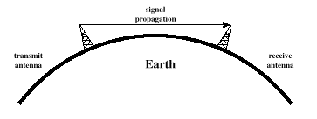
Line-of-Sight Propagation
Non Line of sight is obstructed by obstacles like buildings
Notes:
Transmitting and receiving antennas must be within line of sight
Satellite communication – signal above 30 MHz not reflected by ionosphere
Ground communication – antennas within effective line of site due to refraction

Slide 4
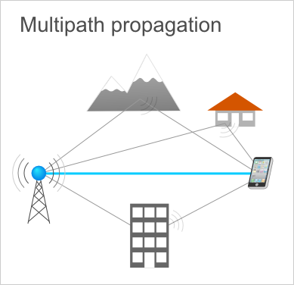
Multipath is a propagation phenomenon that causes the transmitted signal to be sent on two or more paths to the receiver.

Slide 5
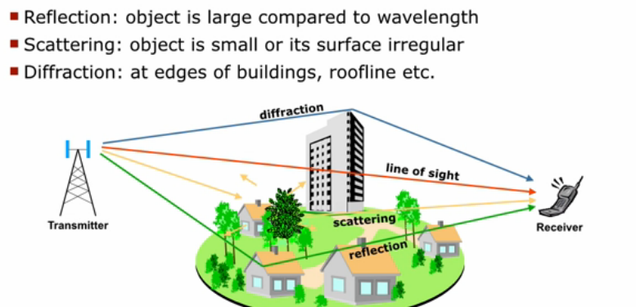

Slide 6
Implication of multipath propagation
Fading
Intersymbol interference

Slide 7
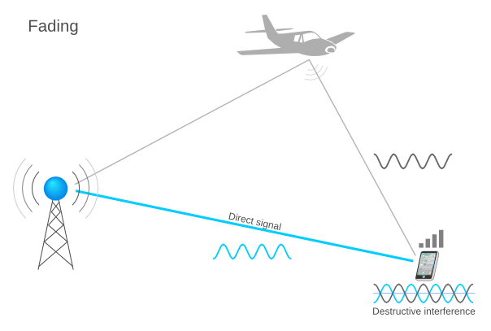
Fading is a phenomenon cause by the constructive and destructive interference of two or more copies of the same signal that arrive at the receiver at different times.

Slide 8
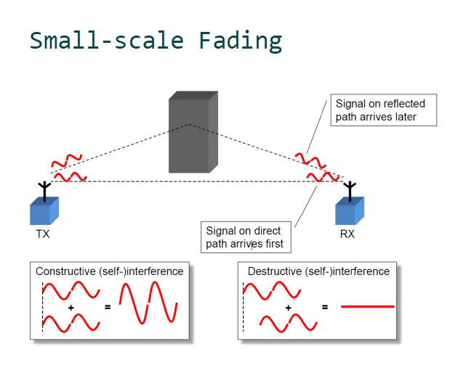

Slide 9
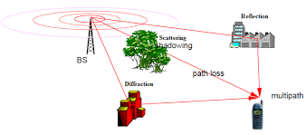
Shadowing : Signal strength loss after passing through obstacles

Slide 10
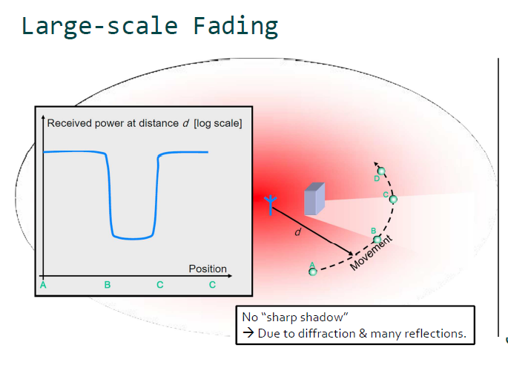

Slide 11
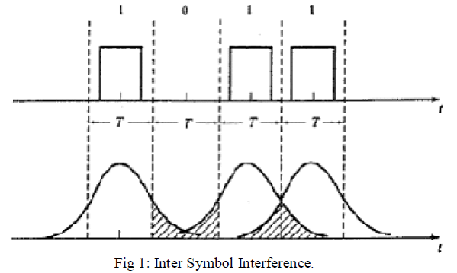
Usually the digital information that is transmitted will be in the form of square waveform representing the 1’s and 0’s. When this square waveform mixes with the noises and non linarites in the channel, the square waveform starts to spread and merge with the adjacent symbol sequence, making the data there to be unreadable. At the receiver end this data is wrongly decoded.

Slide 12
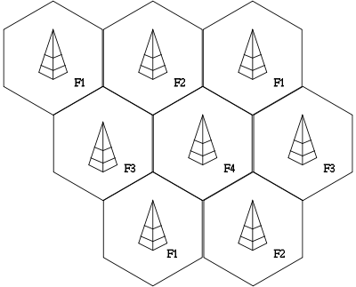
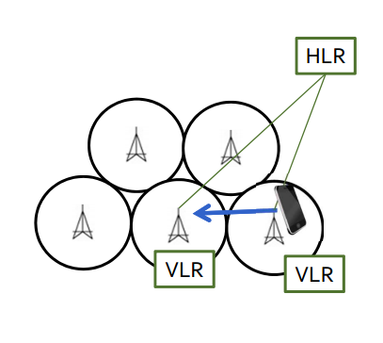
User Mobility
Home Location Register (HLR) and the Visitor Location Register (VLR).
If an MS moves across a cell boundary, a different BS becomes the serving BS; in other words,
the MS is handed over from one BS to another.

Slide 13
If there is an incoming call for a certain MS (user), the network has to know in which cell the user is located.
The first requirement is that an MS emits a signal at regular intervals, informing nearby BSs that it is “in the neighborhood.”
Two databanks then employ this information: the Home Location Register (HLR) and the Visitor Location Register (VLR).
The HLR is a central database that keeps track of the location a user is currently at; the VLR is a database associated with a certain BS that notes all the users who are currently within the coverage area of this specific BS.
Consider user A, who is registered in San Francisco, but is currently located in Los Angeles.
It informs the nearest BS (in Los Angeles) that it is now within its coverage area; the BS enters that information into its VLR. At the same time, the information is forwarded to the central HLR (located, e.g., in New York).
If now somebody calls user A, an enquiry is sent to the HLR to find out the current location of the user. After receiving the answer, the call is rerouted to Los Angeles. For the Los Angeles BS, user A is just a “regular” user, whose dataare all stored in the VLR

Slide 14
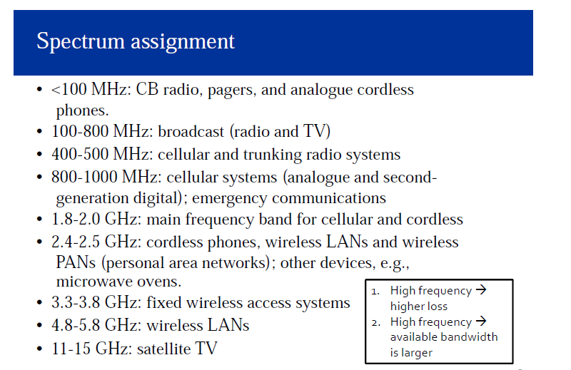
Spectrum limitations

Slide 15
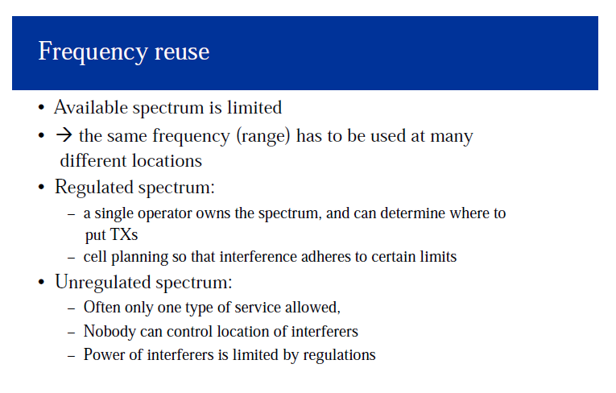

Slide 16
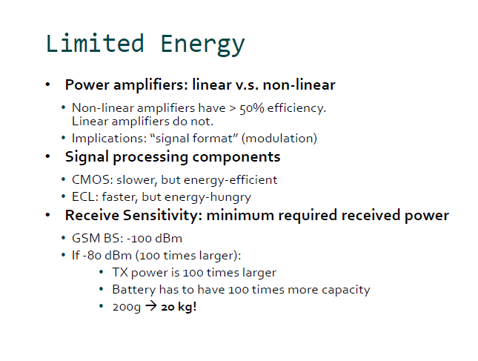

Slide 17
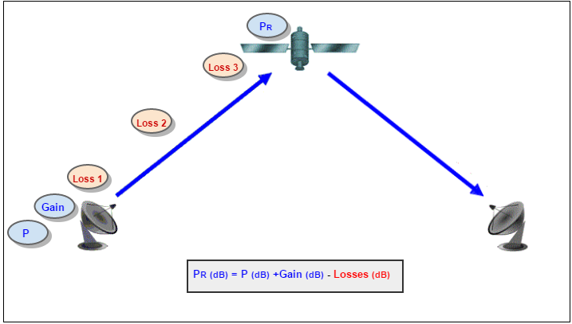
A link budget is accounting of all of the gains and losses from the transmitter, through the medium (free space, cable, waveguide, fiber, etc.) to the receiver in a telecommunication system.
Need: To be able to calculate how far we can go with the equipment we have

